Slide 1






Stick Breaking
Break a stick of length twice:
break at ,
break again at ,
What is the PDF of and its expectation?
Example in conditional probability

Slide 2
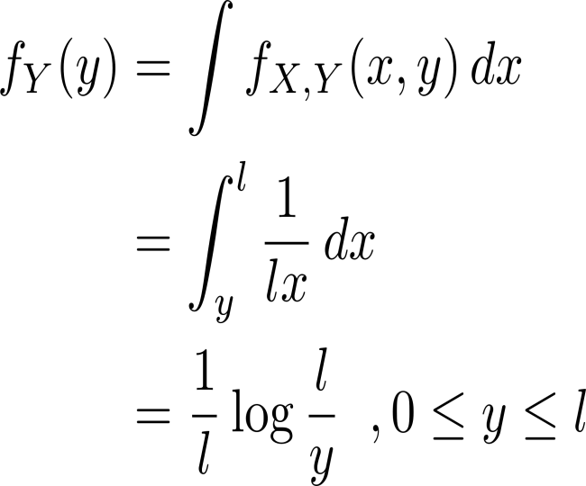
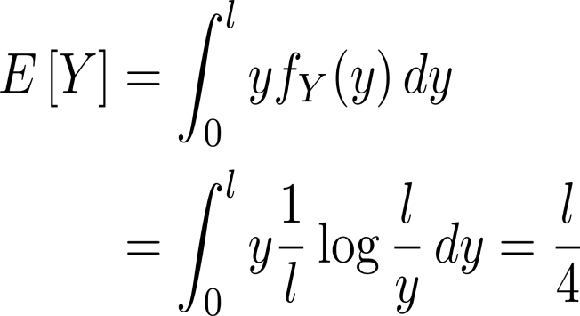
Stick Breaking Cont’

Slide 4



Buffon’s Needle

Slide 5
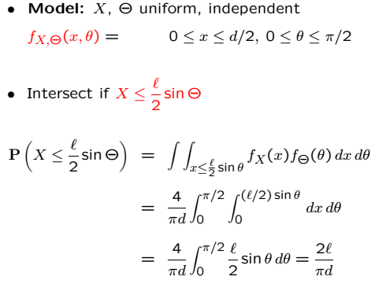
Buffon’s Needle Cont’

Slide 6
Acknowledgements and Citations
Parts of these slides are adapted from the following resources:
Power Point Lecture Slides for the Textbook http://bcs.wiley.com/hebcs/Books?action=index&bcsId=8676&itemId=1118324560
John Tsitsiklis. 6.041 Probabilistic Systems Analysis and Applied Probability, Fall 2010. (Massachusetts Institute of Technology: MIT OpenCourseWare),http://ocw.mit.edu (Accessed 13 Apr, 2015). License: Creative Commons BY-NC-SA

